Slide 1


Why Interscholastic Athletics
& OHSAA Beliefs

Slide 2
• Why Interscholastic Athletics? •
• Ohio HS Athletic Assoc. Beliefs •
Participating in interscholastic athletics programs:
Nothing like palying for your school.
Fosters a sense of community and teaches lifelong lessons of hard work, teamwork, citizenship, and discipline.
Promotes a lifetime appreciation for sports and healthy lifestyles.

Slide 3
• Why Interscholastic Athletics? •
• Ohio HS Athletic Assoc. Beliefs •
Participating in interscholastic athletics programs:
Helps prepare you for the next level of your life as a responsible adult and productive citizen.
Interscholastic athletics programs are not designed to prepare you for the next level of sports.

Slide 4
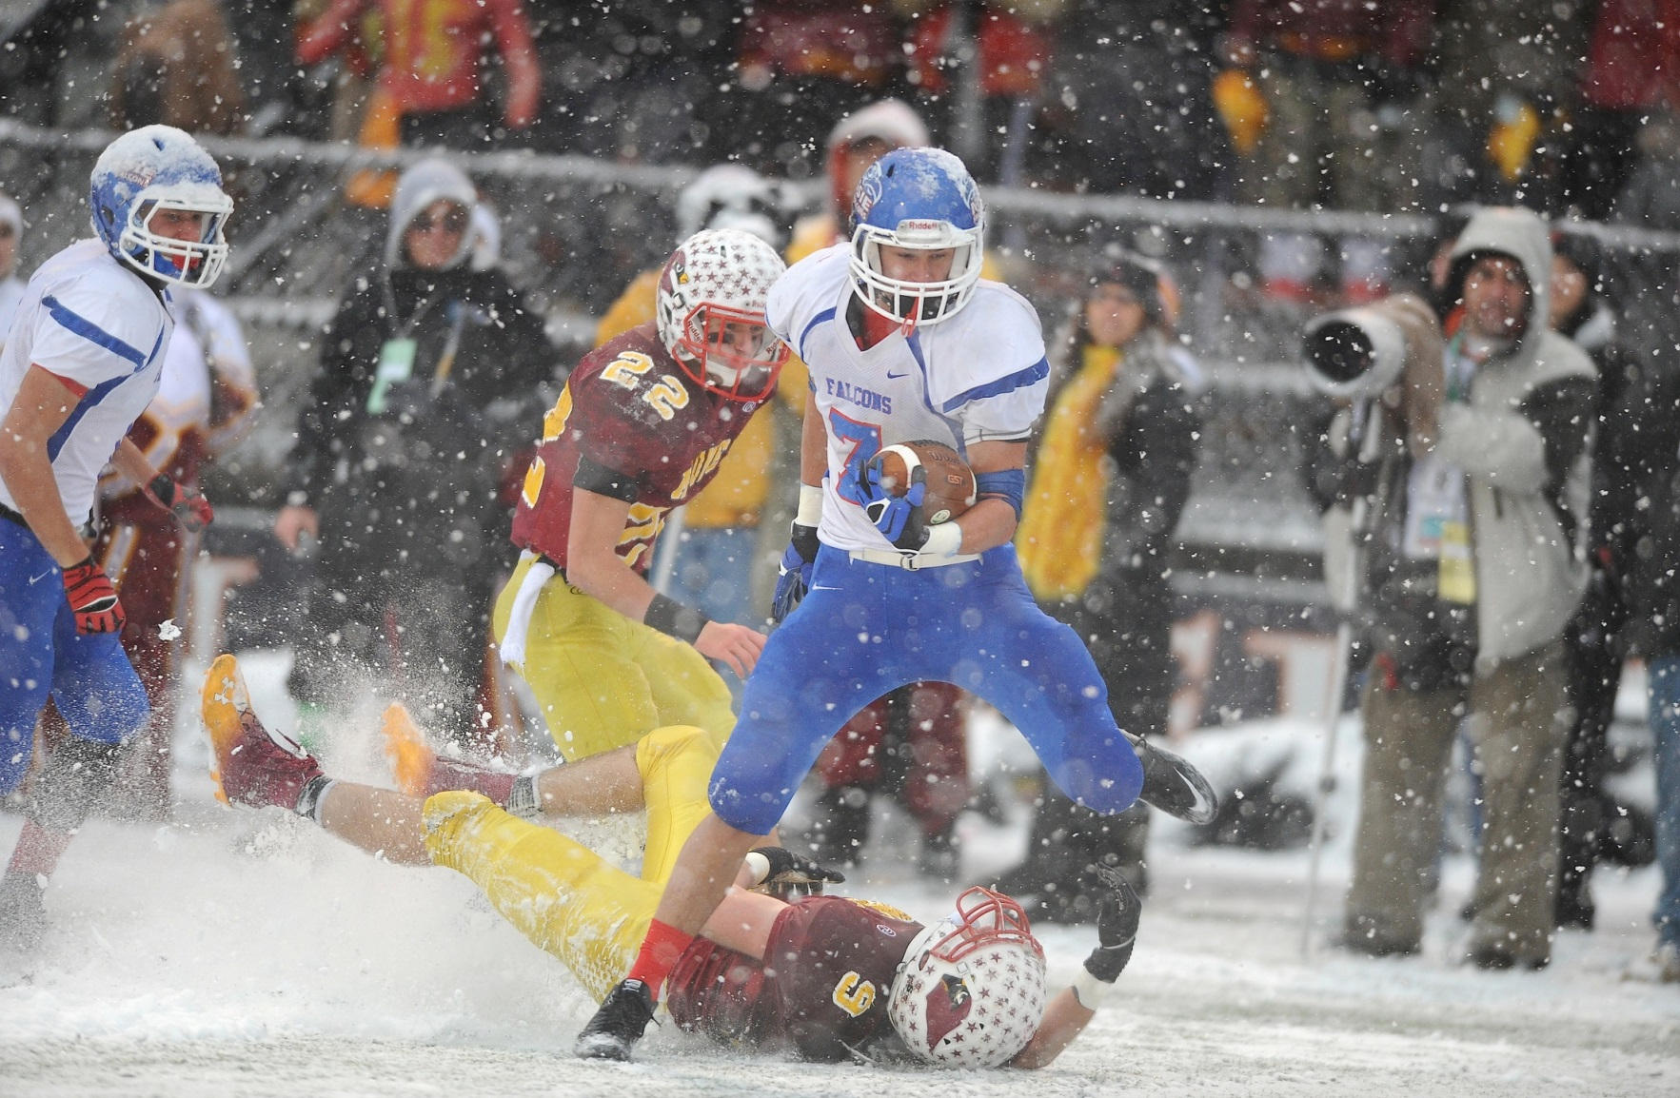
Basic Ohio HS Athletic Assoc.
Rules & Regulations

Slide 5
OHSAA Scholarship Standards
High School
All incoming 9th graders must have received passing grades in a minimum of four of the subjects in which they received grades in the
immediately preceding grading period.(Fall Only)
To maintain eligibility, high school students must have received passing grades in a minimum of five one-credit courses, or the equivalent,
in the immediately preceding grading period.

Slide 6
OHSAA Scholarship Standards
Middle School
All incoming(Fall Only) seventh graders are eligible insofar as the scholarship bylaw,
regardless of previous academic achievement.
To maintain eligibility, 7th and 8th grade students
must have received passing grades in
a minimum of four of the subjects in which they received grades in the immediately preceding grading period.

Slide 7
• OHSAA Scholarship Standards: HS
Students taking College Credit Plus must comply with OHSAA scholarship standards. Grades must be submitted at same time CHS grades are due.
All students participating via state law that permits home educated, non-public, community and
STEM school students to participate at public schools must also comply with OHSAA scholarship standards. Grades must be submitted at same time CHS grades are due.(Check in with Mr. Dement)
Semester and yearly grades have NO effect on
Ohio High School Athletic Association eligibility.

Slide 8
• OHSAA Scholarship Standards: HS
A student who does not take enough courses in the fourth quarter (the final grading period of the academic year) or who fails fourth-quarter courses may not use summer-school courses or grades to regain OHSAA eligibility.
If you drop a course or change your schedule, contact your athletic administrator to see if this affects your eligibility.
This is critically important.

Slide 9
• OHSAA Scholarship Standards: HS
The OHSAA has no minimum grade point (GPA) requirement.
CCS BOE had adopted a policy that a minimum GPA of 2.0 for your quarter grades is required to maintain Athletic Eligibility.

Slide 10
CHS Eligibility Highlights
GPA must be at least 2.0
1.5 ≤ GPA < 2.0?
Must attend study tables
Study Tables:
7-7:45 a.m., Tuesday through Friday, W205
Eligibility is based on the previous nine weeks’ grades (quarter grades). Neither semester grades nor exam grades affect eligibility
If you are a CHS athlete, do not change your schedule without letting me approve the change.
Notes:
Please explain study tables. Do teachers supervise? Do teachers tutor? Do students work independently, or have adults there to answer their questions? Are coaches present?

Slide 11
Academic Eligibility for HS Athletes
GPA at End of Quarter | Letter Grades | Credits Earned | Eligibility | Requirement
< 1.5 OR | ≥ 2 F’s OR | < 5 | Ineligible | Raise grades to restore eligibility later on.
1.5 ≤ GPA < 2 | ≤ 1 F | ≥ 5 | Eligible only with Academic Intervention | Academic Intervention for remainder of season. Must attend ≥ 2 interven-tion sessions per week.
> 2.0 | ≤ 1 F | ≥ 5 | Good to go! | A parent may request that student athlete attend the intervention program
Notes:
Is “Raise grades to restore eligibility later on” correct? Please change as appropriate. Thank you.

Slide 12
CMS ELIGIBILITY HIGHLIGHTS
GPA must be at least 2.0 with passing grades in at least 4 courses in the most recently completed quarter
If GPA is at least a 1.5, but below a 2.0, student is placed on academic probation until midterm grades are officially published for the next quarter
When midterm grades are posted,
if GPA for that current quarter is 2.0 or higher the the student athlete is eligible for the remainder of the quarter.

Slide 13
Academic Eligibility for MS Athletes
GPA at End of Quarter | Letter Grades | Timing | Eligibility | Requirement
≥ 2.0 | Passing 4 | Most recently completed quarter | Eligible
1.5 ≤ GPA < 2 | Passing 4 |  | Academic Probation | Academic Probation until midterm grades for next quarter are posted.
> 2.0 | Passing 4 | Midterm | Good to go! | Eligible for the remainder of the quarter.
Notes:
Say grades in Q1’s first half require probation. Probation lasts only until midterm if student raises grades?
Say grades in Q1’s second half require probation. Does probation last until Q1 ends, or up to Q2’s midterm point?
In row 2, what value for the “Timing” column? Are grades calculated only at midterm and quarter’s end, or does student know GPA and number of F’s throughout a quarter?

Slide 14
CMS ELIGIBILITY HIGHLIGHTS
If GPA is below a 2.0 at midterm for any academic intervention student, he or she is ineligible for the remainder of that quarter
Please keep in mind that at the MS level,
ELA is a block class so whichever grade you earn is counted twice.
In other words, DO NOT FAIL ELA!

Slide 15
• OHSAA Semester Limits •
High school students have eight consecutive semesters of athletic eligibility. Middle school students have four consecutive semesters of eligibility.
HS students become ineligible once they turn 20. MS students become ineligible if they are 15 prior to August 1st.

Slide 16
OHSAA Standards:
Non-School Teams,
Out-of-Season Activities
During your school team’s season, DO NOT compete on a non-school team in the same sport. You will become ineligible for the school team.
Outside of a school team’s season, conditioning programs and open gym sessions are optional.
Coaches and schools cannot require that you participate in an open gym/open facility OR in a conditioning or instructional program. Violations of this regulation will result in penalties.
Notes:
Is new second bullet correct? State something in the affirmative when you can.

Slide 17
OHSAA Standards:
Non-School Teams,
Out-of-Season Activities
OHSAA has restrictions regarding tryouts, practices, and competitions with non-school teams
before, during and after the school season.
OHSAA also restricts the instruction you can receive from school coaches outside of your season.
Before participating with a non-school team or receiving instruction outside the season from your school coaches, meet with your athletic administrator or visit the OHSAA website (www.OHSAA.org) to ensure all regulations are being followed.

Slide 18
• OHSAA Transfer Standards •
Once you establish eligibility at an OHSAA high school:
If you transfer to another school, you will be ineligible for all contests after
the first 50 percent of the maximum allowable regular season contests
including the postseason in any sport in which you participated during the previous 12 months.
Notes:
Original text: Once eligibility has been established at a member high school and you transfer to another school, you will be ineligible for all contests until the first 50 percent of the maximum allowable regular season contests have been competed in any sport in which you participated during the previous 12 months.

Slide 19
• General OHSAA Eligibility Standards •
Some exceptions to OHSAA regulations exist.
If you believe you qualify for an exception, or if you have questions about your eligibility or about any of the regulations,
please consult with your school principal or athletic administrator.
Ask your school principal or athletic administrator to discuss any unresolved issues with the administrators in the OHSAA office who handle eligibility issues.

Slide 20
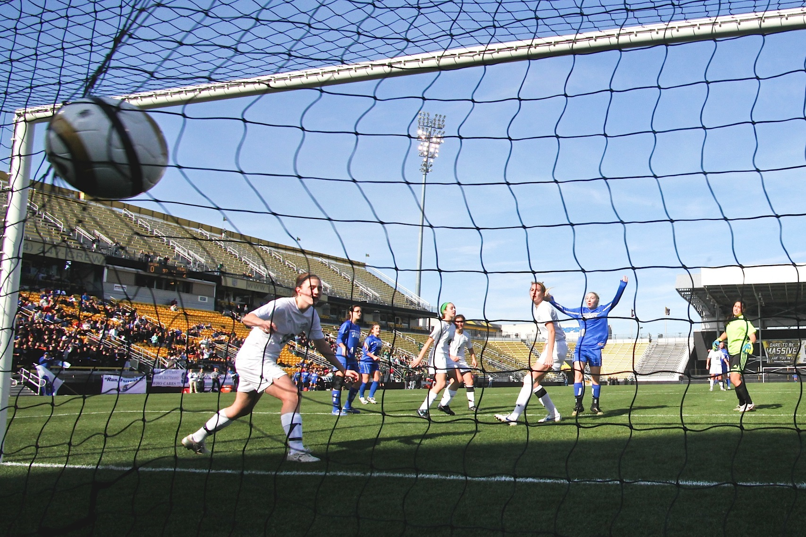
Your Health & Safety

Slide 21
Sports Physicals, Forms
Before a season starts, each student athlete must have a valid physical. Complete and turn in these forms to the high school athletic director’s office:
 | Form
 | OHSAA Preparticipation Physical Evaluation (6 pages)
 | Emergency Medical Authorization Form (1 page)
 | Ohio Dept. of Health Concussion Information (1 page)
 | Centerville City Schools Code of Conduct Form (4 pages)
 | Sudden Cardiac Arrest and Lindsay’s Law Parent/Athlete Signature Form (1 page)
Forms are available at https://goelksathletics.com/ All forms are under the Athletic Forms tab

Slide 22
Pay to Participate
Each athlete’s “pay to participate” fee is due by the first official game.
We will always work with a family in need. Please call the Athletic Director if you need assistance.
Cost | Activities
$225 | All HS teams except cheer, cross country, tennis, swimming, bowling
$180 | HS cross country, swimming, tennis, bowling
$135 | All MS teams except cheer, cross country, track
$113 | HS cheerleading
$68 | MS cheer, cross country, track
$450 | Student Maximum
$563 | Family Maximum
Notes:
We would like every student/athlete to pay his/hers’ pay to participate fee by the first official game. We will always work with a family in need.(Please call AD if you need assistance)
$225 All HS teams except cheer, cross country, tennis, swimming, bowling
$180 HS cross country, swimming, tennis, bowling
$135 All MS teams except cheer, cross country, track
$113 HS cheerleading
$68 MS cheer, cross country, track
Student max = $450 Family max = $563
Make checks payable to “Centerville City Schools.”
HS payments are submitted to Bookkeeper in Central Unit
MS payments are submitted to the office of the school the child attends
You may call 439-3572 to pay by credit card

Slide 23
Pay to Participate (continued)
Make checks payable to
“Centerville City Schools.”
High school: Submit payments to Bookkeeper in Central Unit or pay
online thru student access center
Middle schools:
Submit payment to office of the school the student attends or pay
online thru student access center
Call (937) 439-3572 to pay by credit card.
Notes:
Make checks payable to “Centerville City Schools.”
HS payments are submitted to Bookkeeper in Central Unit
MS payments are submitted to the office of the school the child attends
You may call 439-3572 to pay by credit card

Slide 24



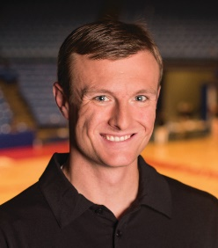
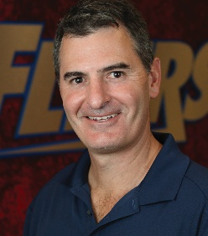
Your Elks Sports Medicine Team
Brandon Craig, MBA, ATC
bccraig@premierhealth.com
(937) 439-3512
Karl Knutsson, MS, LAT, ATC
legrunke@premierhealth.com
(937) 439-3512
Jace Hill, ATC
jthill@premierhealth.com
(937) 439-3512
Jeffrey James, DO
Team Physician
Joe Rubino, MD
Orthopedic Consultant
Notes:
*Centerville City Schools

Slide 25
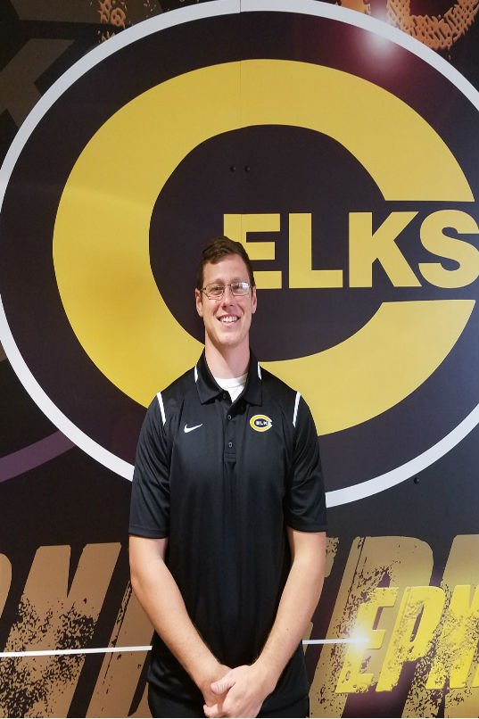
SPORTS MEDICINE
Lead Athletic Trainer
Brandon Craig (Football, B/G Golf) brandon.craig@centerville.k12.oh.us
Office: (937) 439-3512
Miami Valley Sports Medicine Center
Notes:
Name and e-mail address seem to be for two different people. Please check.

Slide 26


SPORTS MEDICINE
Athletic Trainers
Karl Knutsson Jace Lanier
karl.knutsson@Centerville.k12.oh.us jace.lanier@centerville.k12.oh.us
B/G XC, Girls Tennis, Girls Volleyball B/G Soccer, Cheer, Dance
(937) 439-3512 (Direct Office Line)

Slide 27
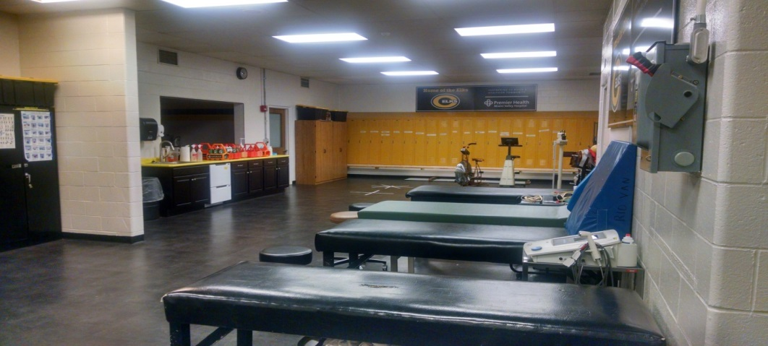
SPORTS MEDICINE
Team Physicians
Dr. Jeffrey James, DO Dr. Joe Rubino, MD
Team Physician Orthopedic Consultant
Office: Office:
(937) 312-1661 (937) 208-2091

Slide 28

SPORTS MEDICINE
Athletic Training Room Hours
Open Monday Through Friday
Hours Are Posted
(10 am – 4 pm for sure)

Slide 29
• Concussions •
In Ohio, any athlete who exhibits signs, symptoms, or behaviors consistent with a concussion . . .
such as loss of consciousness, headache, dizziness, confusion or balance problems . . . shall be IMMEDIATELY removed from the contest or practice and shall not return to play that same day.
Thereafter, the student shall not return to practice or competition until cleared with WRITTEN AUTHORIZATION from a physician or health care provider approved by the local board in accordance with state law.

Slide 30
• Concussions •
Each school is required to review its concussion management protocol with you and your parents.
In addition, you and your parents must review and sign the Ohio Department of Health’s “Concussion Information Sheet” prior to participation.
We highly encourage you to review a short presentation on concussions available at no cost (www.nfhslearn.com).

Slide 31
• Concussions •
While return-to-play policies are very important,
parents must also work with school administrators and teachers
in developing concussion management guidelines for student-athletes
who have been concussed and are returning to the classroom
(i.e. Return to Learn).

Slide 32
Concussion/Return-To-Play
Policy Highlights
Signs and symptoms of a concussion
Treatments for concussions
All concussions need to be cleared by a physician to start return-to-play protocol
Return to play protocol has 6 steps
Immediate Post-Concussion Assessment and Cognitive Testing (ImPACT)
Physician must order post-concussion test
Concussion forms

Slide 33
Athletic Code Of Conduct
We are here to help you in the overall education of your child.
A student-athlete who signs the code of conduct commits to demonstrating integrity, being a model citizen, and representing Centerville well.
Once your son/daughter signs the policy, it is in effect for 365 days. It forbids unacceptable conduct, such as disrespect or breaking the law.

Slide 34
Athletic Code Of Conduct
(continued)
Using drugs, alcohol, or tobacco (violation 1) disqualifies the student from 20% of regular-season competitions. Penalties may continue into the next sports season. Student still may practice. Student will be sent to counselor. Completing 20 hours of community service can reduce penalty to 10% of competitions.
Using drugs, alcohol, or tobacco a second time (violation 2) disqualifies the student for 365 days. May not practice. Community service can reduce penalty to six months.
Using drugs or alcohol a third time (violation 3) ends the student’s middle school or high school athletic career. After one year, student may apply for reinstatement.

Slide 35
Athletic Code Of Conduct
(continued)
A student who breaks the code of conduct may attend competitions but not dress for them.
A student who breaks the code of conduct may not participate in an end-of-season award program, will not receive individual or team awards (for instance, 9th-grade numerals or varsity awards), and becomes ineligible for the Scholar-Athlete Award.
A student who breaks the code of conduct then quits a team must pay the penalty (suspension) when the student subsequently joins a team.
To receive any award, a student-athlete must finish the season in good standing.
OPIOID INFORMATION HANDOUT

Slide 36
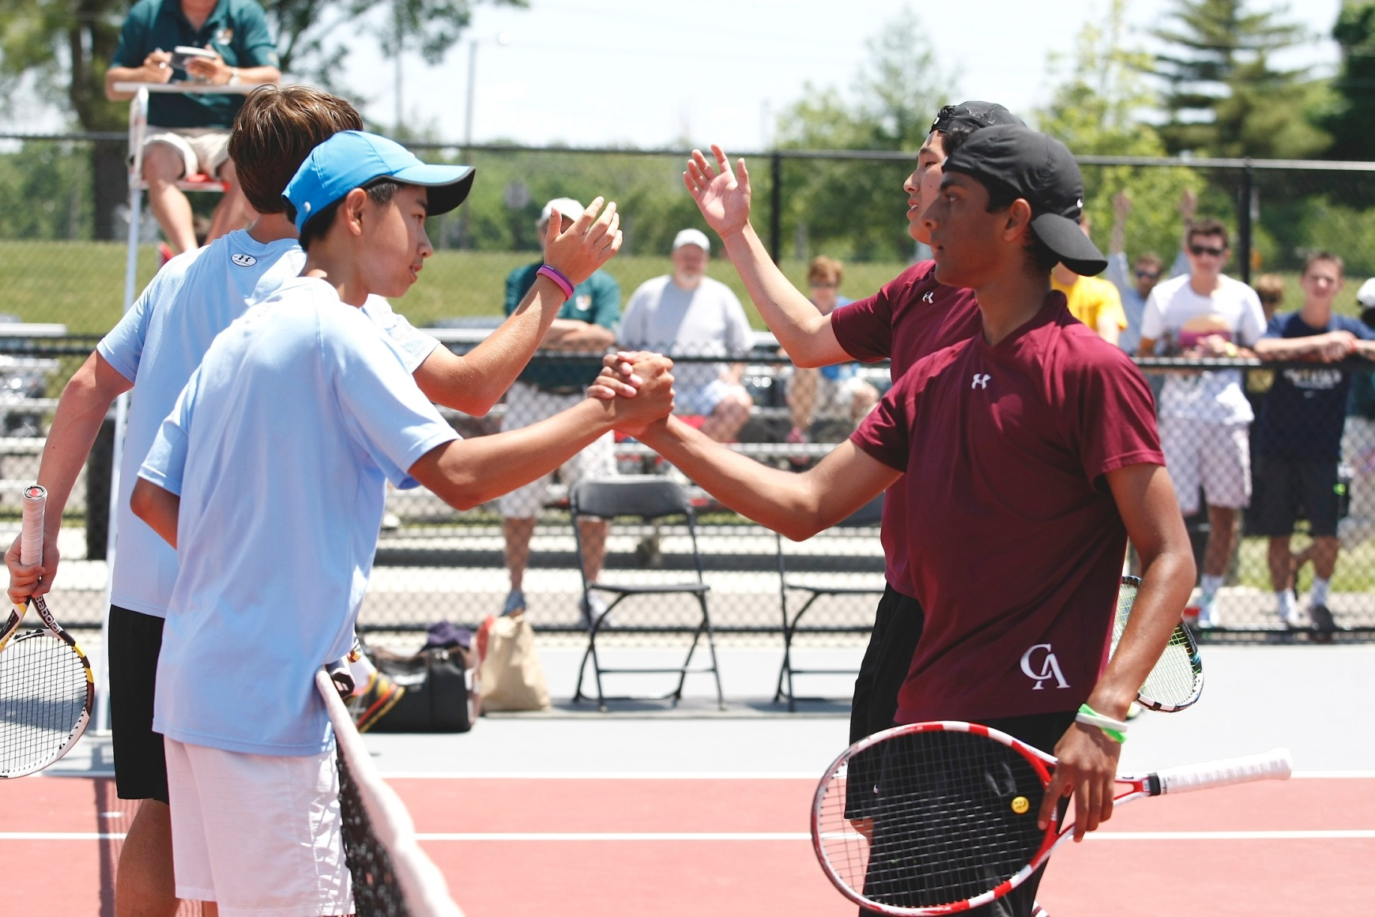
Sporting Behavior

Slide 37
Practice Schedules
Coaches will distribute practice schedules.
Practices will end when scheduled to end. If that does not happen, please let me know.
In-season sports have priority for our facilities.

Slide 38
Game Schedules
All game schedules are online at www.goelksathletics.com
Look under the season, the sport, and the level (varsity, JV, 9th grade, 8th grade, or 7th grade). Schedules are updated in real-time.
Please do not call the Athletic Office until after 12 pm to ask about a cancelled game.
We will put all information on the website. We will alert you through text messages, Twitter, and Facebook!
You may call Kara Dierker at (937) 439-3516

Slide 39
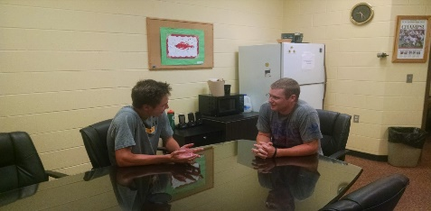
Players, Parents:
Raising Concerns With Coaches
1. During or immediately after
a practice or a game, a parent should not raise concerns with a coach.
2. If a student has a concern, he or she should speak to the coach directly.
If the player (or the parent) is not satisfied, the parent can ask to meet with the coach (typically with the student present).

Slide 40
Players, Parents:
Raising Concerns With Coaches (continued)
3. If the player or parent still has concerns after meeting with the coach, please call the Athletic Office at (937) 439-3517.
The Athletic Director first will ask the parent(s) if the student has talked with the coach.
We will schedule a meeting the includes the player, the parent(s), the coach, and the athletic director.

Slide 41
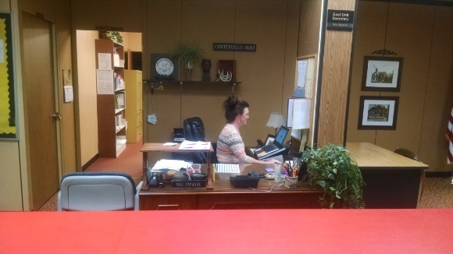
Attendance Policy
A student-athlete must attend school for at least 3 periods to be eligible for either a practice or a game that evening.
Doctor appointments, funerals, and field trips do not count against the student when determining eligibility.
If your son/daughter is not feeling well and wants to sleep in, he or she must be at school by the start of 5th period to practice or play that night.

Slide 42
RIDING THE BUS (HS)
Our student-athletes are expected to ride to and from events on the bus.
Alternate Transportation Request Form (release) must be filled out at least 24 hours before an event. After student and parent sign the form, ask Athletic Director to sign it. Then ask head coach to approve and sign the form. (See https://centervilleelkathletics.com, More, “Alternate Transportation Request Form.”)
Only the parent of the child can transport the child.

Slide 43
RIDING THE BUS (MS)
Practices:
MS student-athletes must find their own transportation to all practices.
Away Games:
Bus(es) will pick up the athletes at their home school to transport them to the site from where the bus will depart. After each away game, the bus(es) will return the teams to whichever school was the official departure site.(Watts or Tower Heights)
Exception for Away Games: MS football(Fall Only)
The 7th grade players and cheerleaders at Watts and Magsig will go by bus to the HS for their departure. The players and cheerleaders from Tower Heights will walk over to CHS.
The 8th grade players and cheerleaders will ride their normal buses home after school unless they also have an early game.

Slide 44
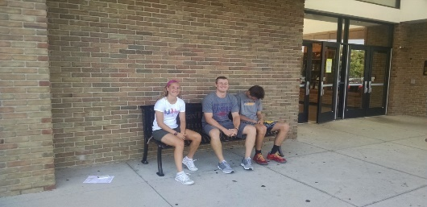
Coaches: First To Arrive, Last To Leave
Coaches will arrive at least 15 minutes before student-athletes are told to arrive.
Please understand that if you have to bring your athlete any earlier that, he or she will not be supervised.
Coaches will end practices when they are scheduled to end.
In return, I ask that you be prompt in picking up your son or daughter. A coach must stay until all athletes are picked up.

Slide 45
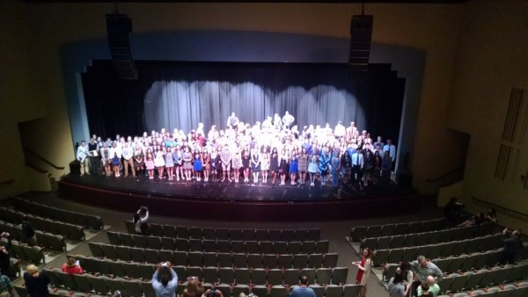
PLAYING AT
THE NEXT LEVEL
There is a place for every one to play at the next level
Less than 3% of all high school athletes earn athletic scholarships
Much easier to earn academic scholarships, grants, etc.
(Over 300 Scholar Athletes, Spring 2021)
Register at www.eligibilitycenter.org if you are interested in
playing college athletics. Qualifications vary depending on the level.
Parents, please do not fall victim to paying big money for a
person to market your son/daughter. Good players will get
found. The coaches and myself are willing to help, just ask.

Slide 46
Admission Prices
Event | Student (K-12) | Adult | Senior
GWOC Varsity except Football | $8 | $8 | $8
GWOC Varsity Football (home, at the gate) | $9 | $9 | $9
GWOC Varsity Football Reserve Seats (home, in advance) $60 for all 5 games |  | $12 if available
GWOC Other Than Varsity | $6 | $6 | $6
GWOC Middle School | $6 | $6 | $6

Slide 47
Pass Prices
Type | Cost | Covers
CHS Student Activity Pass | $160 | All home athletic contests except OHSAA tournament games. Also fall play, spring musical, school newspaper, and yearbook
All-Season Sports Family Pass (academic year 2021-2022) | $300 $350 $400 | All home athletic contests except OHSAA tournament games. For all members living in the same household. (Up to 4, 6 or 8 household members) All passes are locate at www.ticketspicket.com, click on But tickets, Type in Centerville Elks and you will find all pass options.
Student Punch Pass(25 Events) | $75
Adult Punch Pass(25 Events) | $100

Slide 49
MEETINGS
Sport | Location
Boys Soccer | South Commons
Girls Soccer | West Commons
B/G Cross Country | Main Gym

